Slide 1
An Open-Source Approach to the Detection and Quantification of Cyanobacterial Harmful Algal Blooms and Water Quality using Remote Sensing
waterquality
Richard Johansen
Molly Reif
Christina Saltus
March 25th 2021

Slide 2
Outline
Project Overview
Introduction to Satellite Remote Sensing & HABs
Open-Source Tool Development
WQ Data & Satellite Imagery Acquisition
Exploring R and WQ related R Packages

Slide 3
Project Overview
Project: Harmful Algal Bloom indicator estimation in small inland waterbodies: Remote sensing-based software tools to assist with USACE water quality monitoring
Purpose: The USACE has the challenge of monitoring hundreds of inland lakes and reservoirs that cover vast geographic areas. Limited resources can lead to reactionary responses to HAB outbreaks. Software tools are needed to assist with remote monitoring.
Goal: Build on foundational research to develop remote sensing software tools to estimate HAB indicators focusing on small, inland waterbodies in support of USACE water quality monitoring needs
Project Team
PI: Molly Reif (CEERD-EEC)
Christina Saltus (CEERD-EEC)
Erich Emery (LRD)
Glen Higdon (SAM)
Richard Johansen (CEERD-EEC)

Slide 4
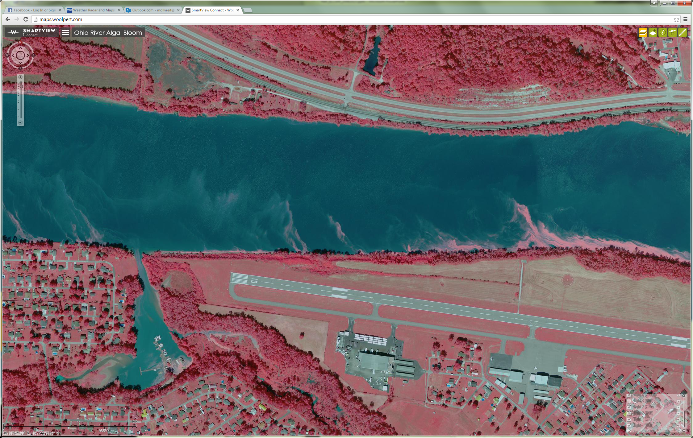
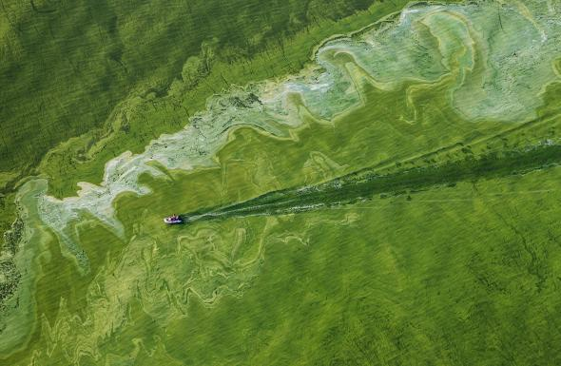
Problem & Cost
Declining water quality continues to be global concern, particularly HABs have seen a dramatic increase in both frequency and extent over the last few decades
Human and Animal Health
HABs produce toxins such as dermatoxins, hepatoxins, and neurotoxins that are “harmful” to both human and animal health
Economic
Increased water treatment
Aquaculture and fisheries loss
Recreational restrictions or closures
Extreme years topping $1,000,000,000 in losses
Water Quality and Ecosystems
The short term impacts may be hypoxic or anoxic conditions resulting in aquatic organism deaths and the altering of the food-web
Persistent long-term effects are still unknown
Ohio River HAB 2015 (~700 miles)

Slide 5
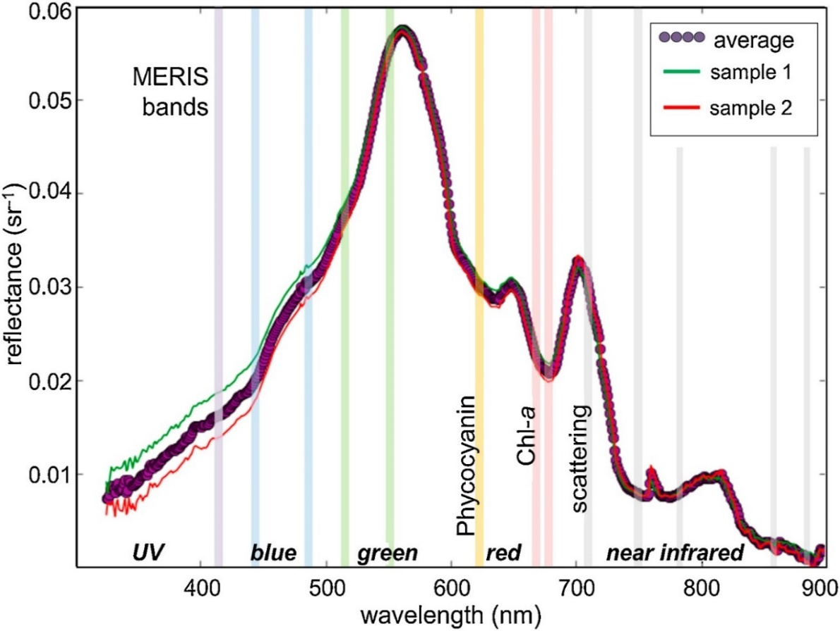
Remote Sensing & Water Quality Proxies
Remote sensing HABs is possible because the photo-reactive pigments produced by algae can be ‘sensed’ by satellite imagers
Chlorophyll(s) (Chl_{a})
Ubiquitous phytoplankton pigment with absorption features around 433 nm and 686 nm and reflectance peaks at 550 nm and 715 nm.
Phycocyanin
Cyanobacteria specific pigment with major absorption feature at 620 nm.
Turbidity
General measure of water clarity
Effect of backscattering caused by suspended material in the water column

Slide 6
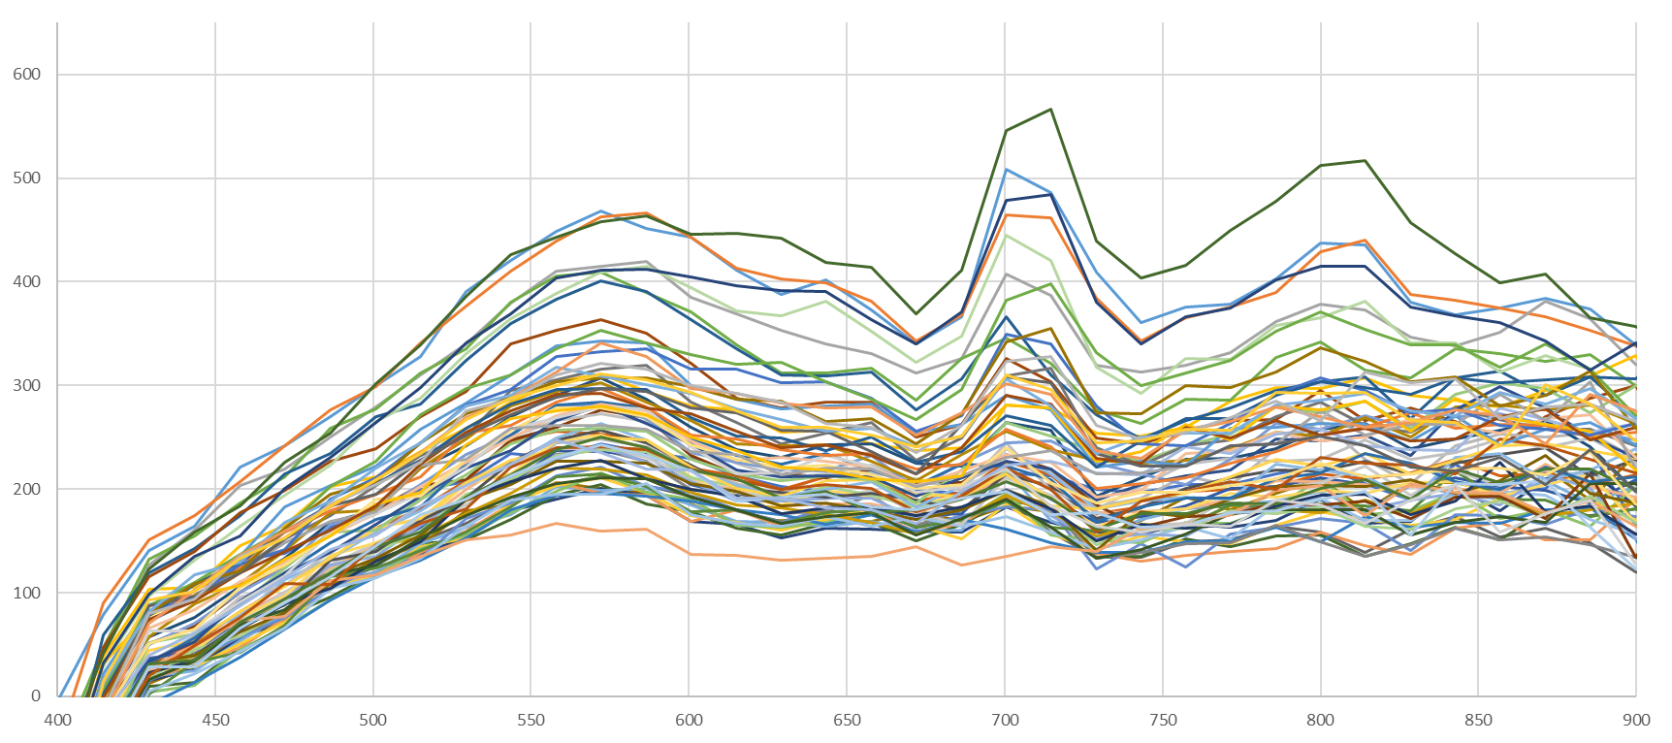
Expectations vs. Reality
Notes:
Relies on Proxies, Water Type, Species Delineation, Satellite Configuration, Atmospheric Corrections Methods, Algorithm Type

Slide 7
Satellite Imagery
Satellite Imager | Spatial Resolution | Temporal Resolution
Worldview-2 | 1.8m | 1.1 days
Sentinel-2 | 10-20m | 5-10 days
Landsat-8 | 30m | 16 days
MODIS | 250m | 1-2 days
MERIS (2002-2012) | 300m | 3 days
Sentinel-3 (OLCI) | 300m | 2-3 days
Imagery acquisition:
European Space Agency (ESA) Copernicus Hub
US Geologic Survey (USGS) Earth Explorer
Atmospheric correction:
Agencies now providing level-2 (atmospherically corrected) imagery directly.
AC techniques may have major implications on the quality of the imagery, but this is beyond the scope of this presentation.
Additional Image processing
Area selection
Band sub-setting

Slide 8
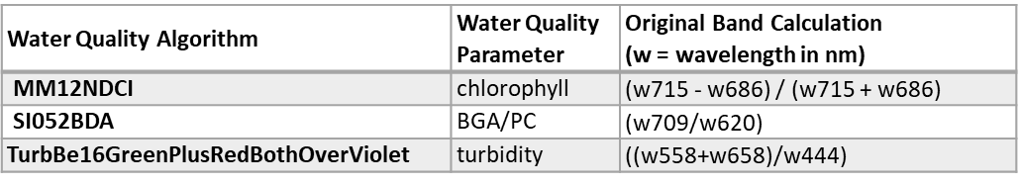
Algorithms
Water Quality Algorithm | Water Quality Parameter | Original Band Calculation (w = wavelength in nm)
Al10SABI | chlorophyll | (w857 - w644) / (w458 + w529)
Am092Bsub | chlorophyll | (w681 - w665)
Am09KBBI | BGA/PC | (w686 - w658)/(w686 + w658)
Be162B643sub629 | BGA/PC | (w644-w629)
Be162B700sub601 | BGA/PC | (w700-w601)
Be162BsubPhy | BGA/PC | (w715-w615)
Be16FLHblue | chlorophyll | (w529) - (w644 + (w458 - w644))
Be16FLHBlueRedNIR | BGA/PC | (w658)-(w857+(w458-w857))
Be16FLHGreenRedNIR | BGA/PC | (w658)-(w857+(w558-w857))
Be16FLHviolet | chlorophyll | (w529) - (w644 + (w429 - w644))
Be16FLHVioletRedNIR | BGA/PC | (w658)-(w857+(w444-w857))
Be16MPI | BGA/PC | ((w615)-(w601)-(w644-w601))
Be16NDPhyI | BGA/PC | (w700 - w622) / (w700 + w622)
Be16NDPhyI644over615 | BGA/PC | (w644-w615)/(w644+w615)
Be16NDPhyI644over629 | BGA/PC | (w644-w629)/(w644+w629)
Be16NDTIblue | chlorophyll | (w658-w458)/(w658+w458)
Be16NDTIviolet | chlorophyll | (w658-w444)/(w658+w444)
Be16Phy2BDA644over629 | BGA/PC | (w644/w629)
Da052BDA | BGA/PC | (w714/w672)
De933BDA | chlorophyll | (w600 - w648 - w625)
Gi033BDA | chlorophyll | ((1 / w672) - (1 / w715)) * (w757)
Go04MCI | BGA/PC | (w709-w681-(w753-w681))
Water Quality Algorithm | Water Quality Parameter | Original Band Calculation (w = wavelength in nm)
HU103BDA | BGA/PC | (((1/w615)-(1/w600))-w725)
Kn07KIVU | chlorophyll | (w458-w644)/(w529)
Ku15PhyCI | BGA/PC | -1*(w681-w665-(w709-w665))
Ku15SLH | BGA/PC | ((w715)-(w658)+(w715-w658))
MI092BDA | BGA/PC | (w700/w600)
MM092BDA | BGA/PC | (w724/w600)
MM12NDCI | chlorophyll | (w715 - w686) / (w715 + w686)
MM12NDCIalt | BGA/PC | ((w700-w658)/(w700+w658))
MM143BDAopt | BGA/PC | ((1/w629)-(1/w659))*(w724)
SI052BDA | BGA/PC | (w709/w620)
SM122BDA | BGA/PC | (w709/w600)
SY002BDA | BGA/PC | (w650/w625)
TurbBe16GreenPlusRedBothOverViolet | turbidity | ((w558+w658)/w444)
TurbBe16RedOverViolet | turbidity | (w658/w444)
TurbBow06RedOverGreen | turbidity | (w658/w558)
TurbChip09NIROverGreen | turbidity | (w857/w558)
TurbDox02NIRoverRed | turbidity | (w857/w658)
TurbFrohn09GreenPlusRedBothOverBlue | turbidity | ((w558+w658)/w458)
TurbHarr92NIR | turbidity | (w857)
TurbLath91RedOverBlue | turbidity | (w658/w458)
TurbMoore80Red | turbidity | (w658)
Wy08CI | BGA/PC | -1 * ((w686)-(w672)-(w715-w672))
Zh10FLH | chlorophyll | (w686)-(w715 + (w672-w715))

Slide 9
waterquality: R Package
Goal:
Develop a “user-friendly” open-source tool that would aggregate a near-comprehensive list of water quality algorithms and allow them to be applied across multiple satellite imagers for the qualitative and quantitative detection and estimation of HABs
But why Develop an R package?
Generally:
R is reproducible and versatile
Programming language common and shareable across disciplines and institutions
Reduces the need for multiple software in a single workflow
Specifically:
There are many water quality algorithms and a “best” algorithm-sensor pair has yet to emerge, so we are still in an exploration phase of research which requires multiple experiments.
Computationally intense: 45 algorithms, 5 sensors, 3 water quality parameters
Complex redundant tasks (prone to error)

Slide 10
Getting Starting with waterquality
Reproducible workflows reduce redundancy, are less prone to user-errors, and more efficient.
We will quickly go through an entire water quality project by using a real-world example
Pre-processing
Imagery acquisition
Atmospheric correction
Additional Image processing (i.e. imagery and band sub-setting)
Applying waterquality
Image analysis
Algorithm evaluation & model validation
Water quality mapping
“Waterquality: An Open-Source R Package for the Detection and Quantification of Cyanobacterial Harmful Algal Blooms and Water Quality”

Slide 11
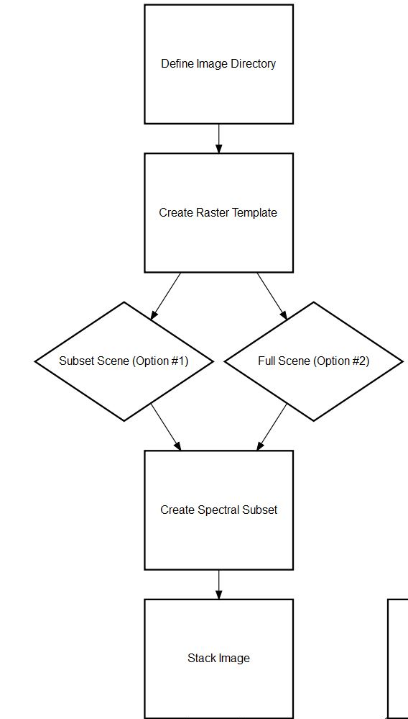
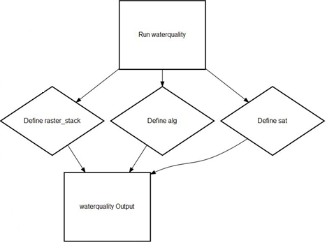
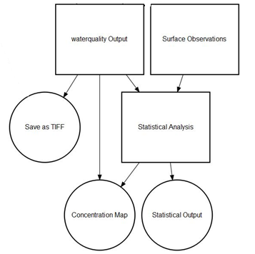
Image Processing
waterquality Model
Analysis & Mapping

Slide 12
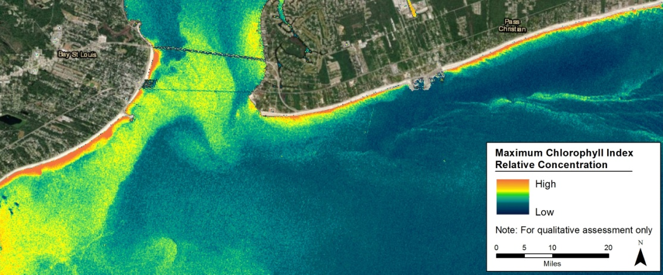
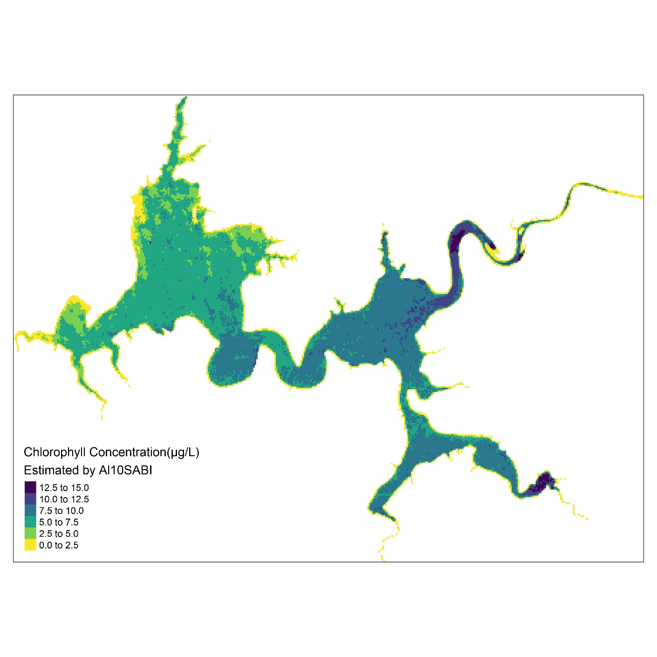
Questions?

Slide 13
Upcoming WQ Projects
waterquality for ARCGIS Pro
Call for beta-testers Early-Mid May
Limited funds will be available beta-testers
Christina Saltus:
Email: Christina.L.Saltus@erdc.dren.mil
Phone: 225-200-8539
Erich Emery:
Email: Erich.B.Emery@usace.army.mil
Phone: 513-684-3041
Molly Reif:
Email: Molly.K.Reif@usace.army.mil
Phone: 228-252-1134
Generalizable Algorithms
New WU focused developing/determining highly portable empirical algorithms across a multitude of variables.
We are currently coordinating with multiple ERDC WU to put out a call for water quality & associated data

Slide 14
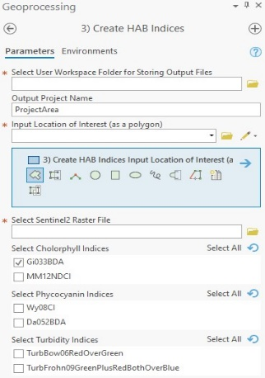
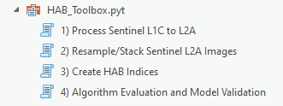

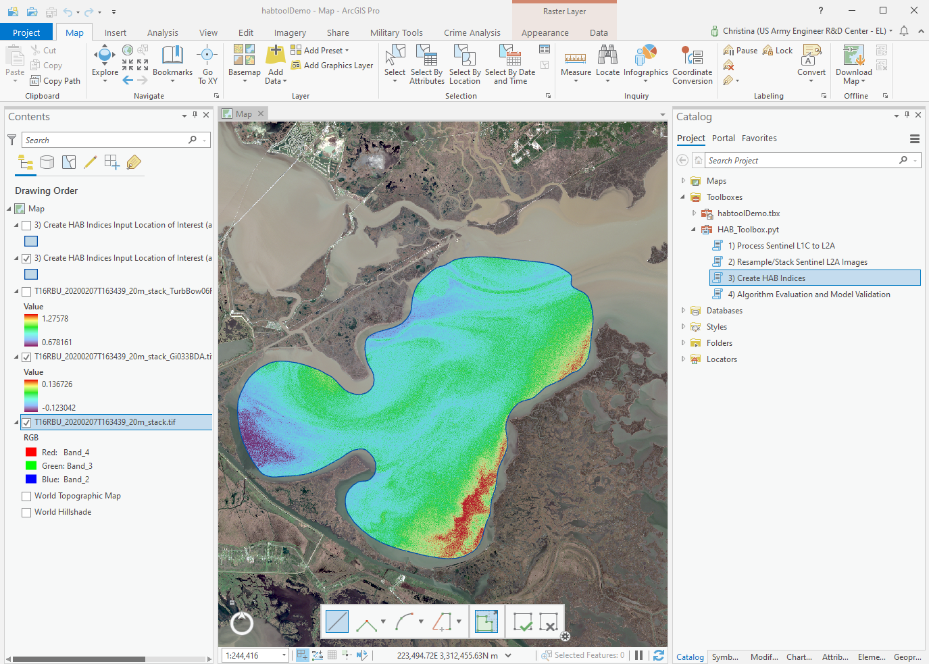
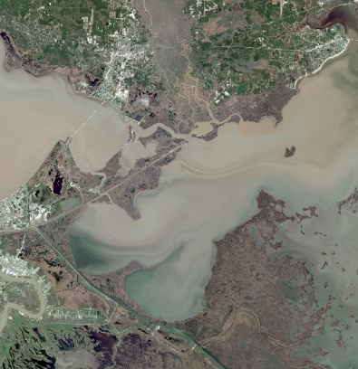
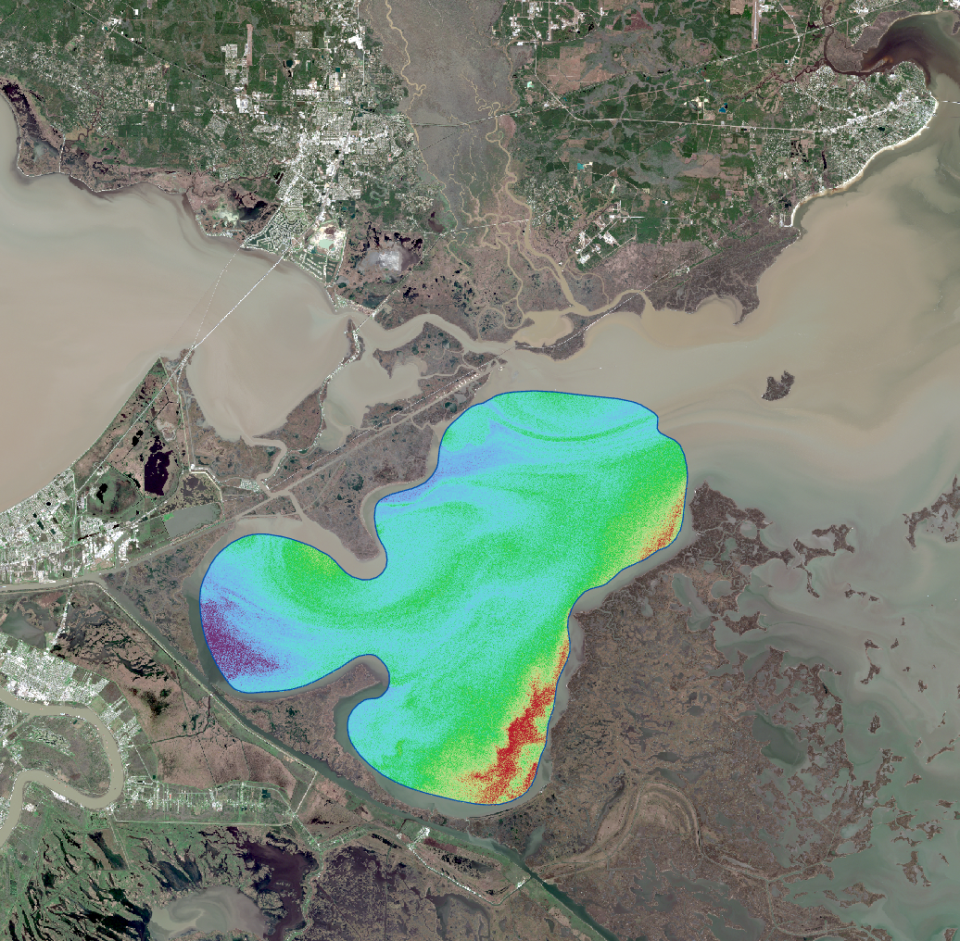
waterquality for ARCGIS Pro
A python-based waterquality toolbox developed in ESRI ArcGIS Pro desktop software to complement the R software package. The toolbox workflow enables water quality managers and personnel to detect, monitor, and quantify water quality using Sentinel-2 satellite imagery.
Available Tools:
Pre-processing Sentinel-2 L1C level imagery
Automates creation of composite Sentinel2 L2A-level image
Converts Sentinel-2 composite image into 6 well-known water quality indices
Converts index raster into estimated concentration values using a regression model and in situ measurements
Tool Requirements:
ArcGIS Pro 2.7
Advanced License
Spatial Analyst Extension
Python 3.7
Output:
Water quality index raster
CSV file of estimated concentration values
Data inputs:
Sentinel-2 satellite imagery
Area of interest polygon
Choice of 6 water quality algorithms
In situ data – csv format
Sentinel-2
Lake Borgne, LA
Gi033BDA Chlorophyll Index
Notes:
Tool requirements:
ArcGIS Pro 2.7
Spatial Analyst Extension
Python 3.7 is automatically installed via default ArcGIS installation (additional installation should not be necessary)
The final algorithm raster images are in relative index values and are not the estimated chlorophyll-a, phycocyanin, or turbidity values, but can easily be converted in to estimated concentration values using a regression model and in situ measurements as described in Johansen et al. 2018.

Slide 15
Supplemental Slides
Imagery Acquisition & Pre-Processing
Slide 16: Data Acquisition/Pre-processing using Sen2R
Slide 17: Sentinel-2 acquisition from USGS Earth Explorer
Slide 18: Sentinel-2 acquisition from ESA Copernicus Hub
Slide 19: Band selection and compositing in ArcGIS
Slide 20: WQ Data acquisition from WQD
Slide 21: Waterquality vignette: Step-by-step function walk-through
Slide 22: USACE WQ Webinar: Location of data*, scripts, and documents used in the webinar.
*excluding very large imagery files

Slide 16
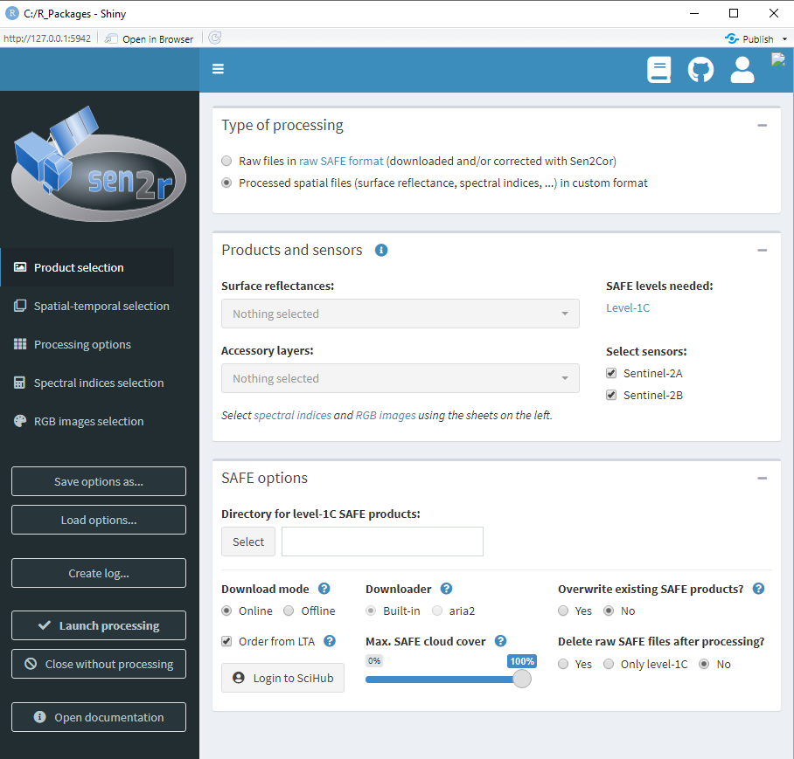
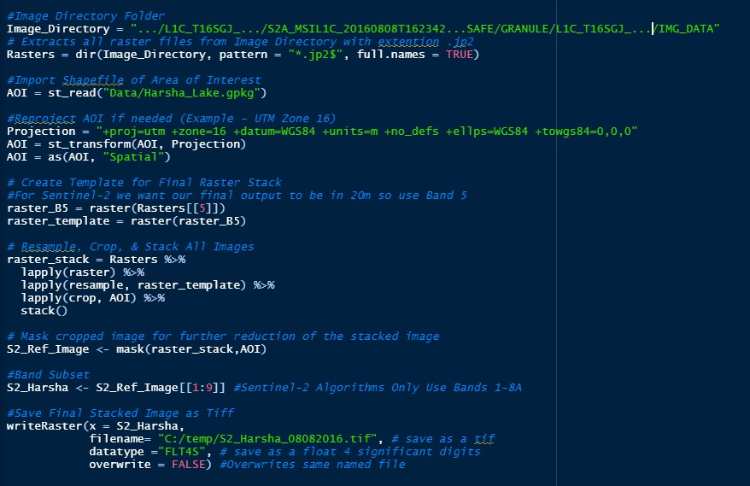
Sentinel-2 Data Acquisition & Pre-processing using Sen2R
Sen2R is a R package with a built-in GUI (Shiny) for easy S-2 data acquisition and pre-processing. https://github.com/ranghetti/sen2r
*We have also developed a small script to run some pre-processing steps.

Slide 17
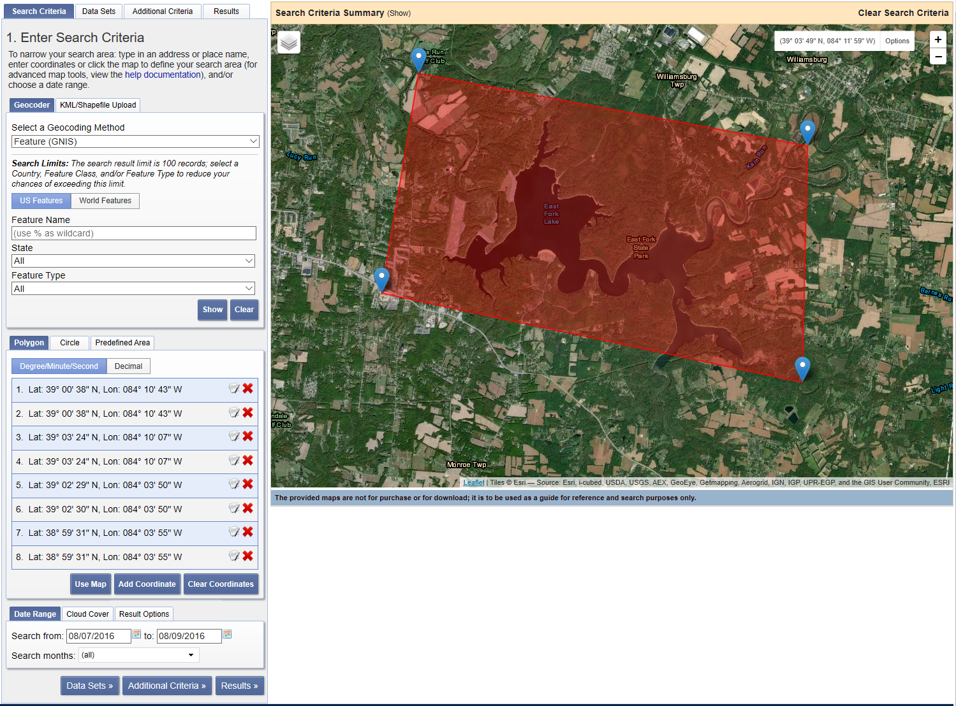
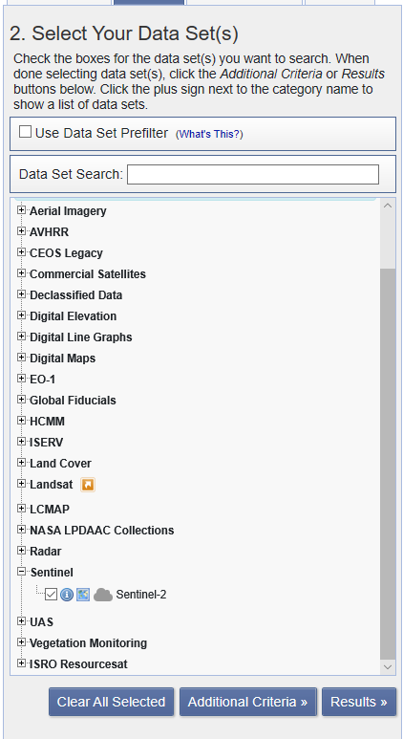
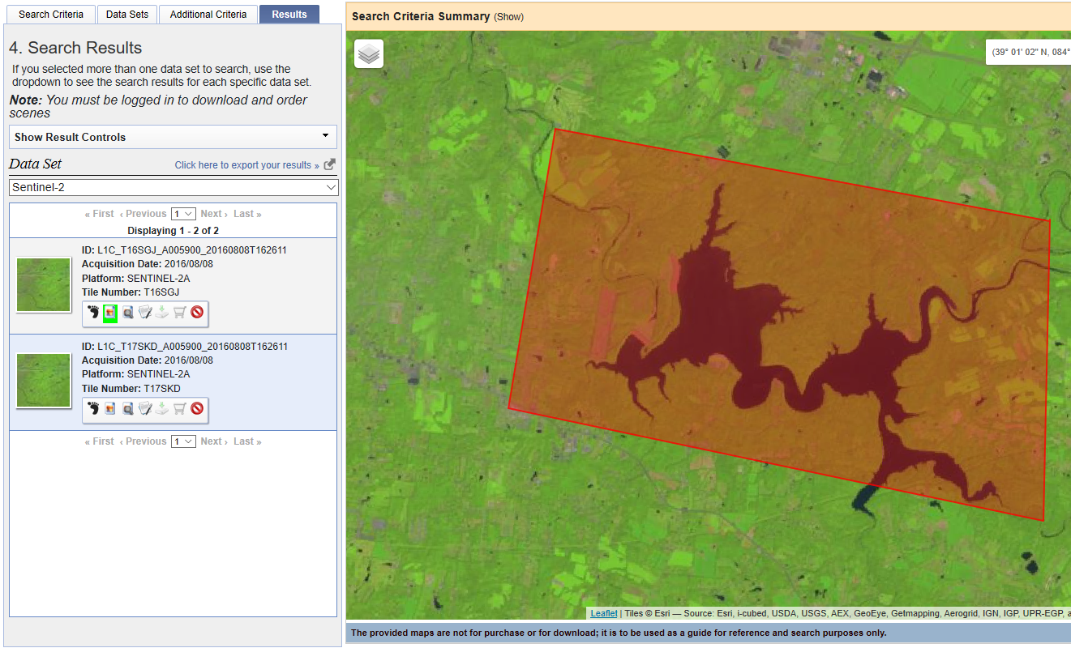
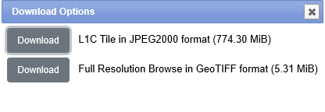
To Download full scenes, you must create an account

Slide 18
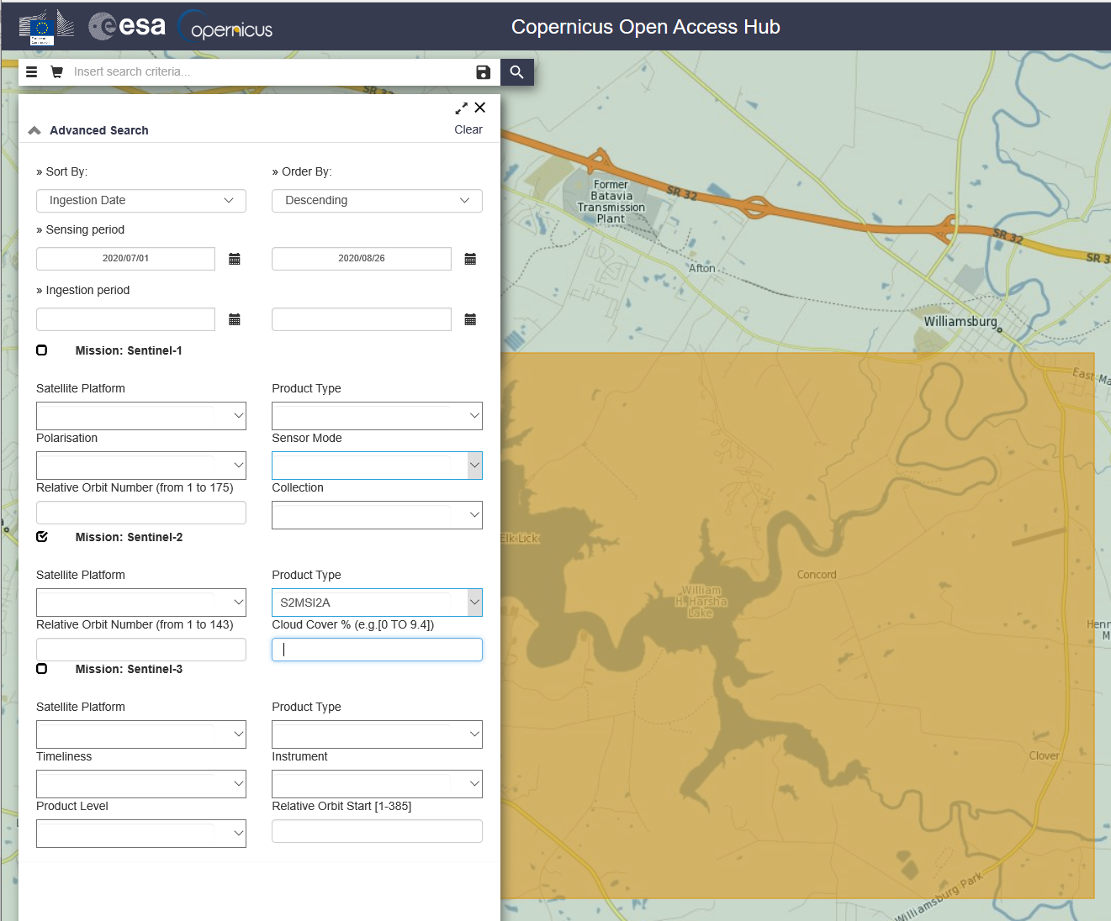
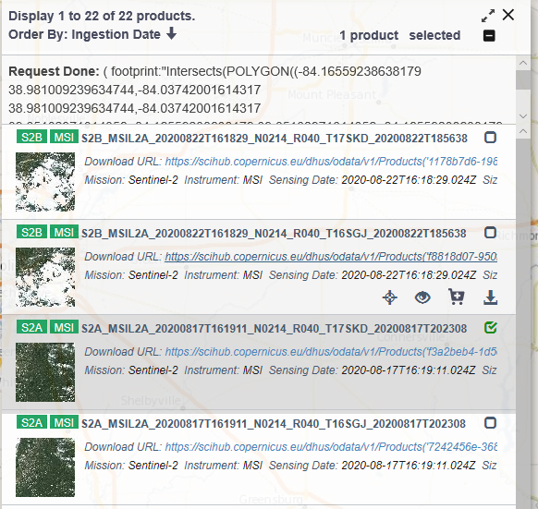

Slide 19
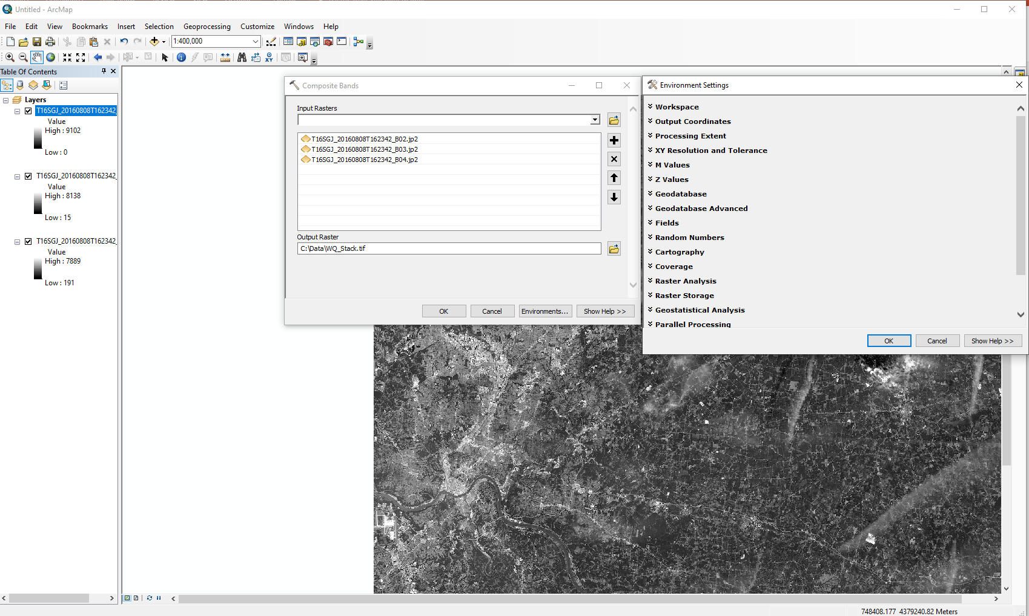
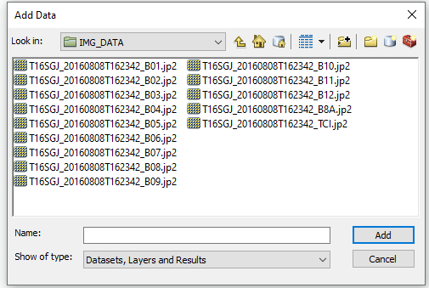
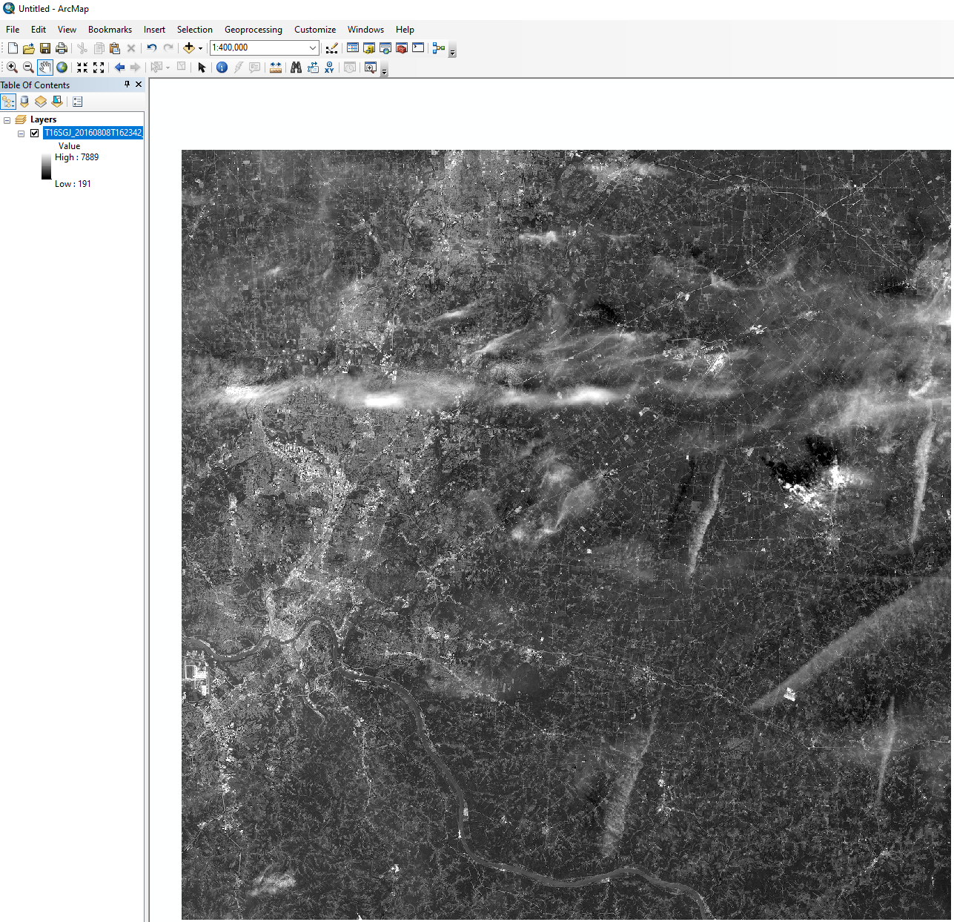
Pre-processing (ArcGIS)

Slide 20
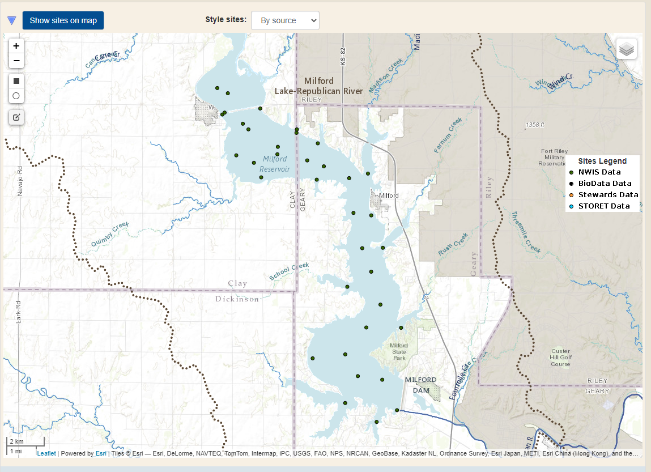
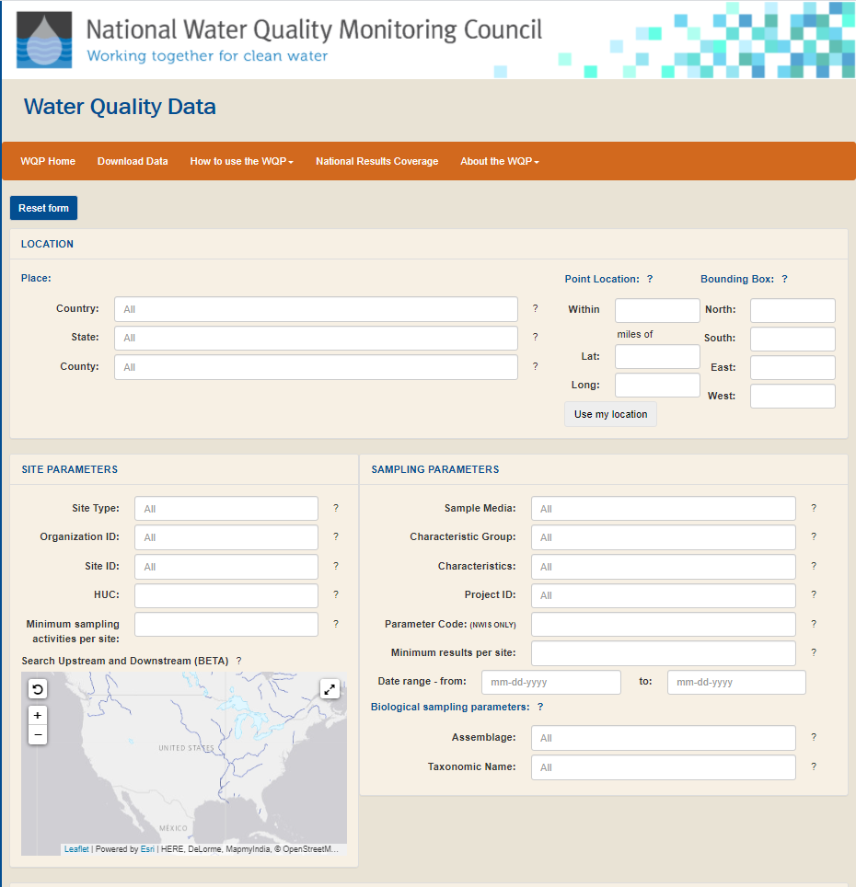
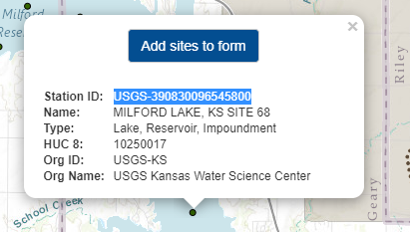
Accessing WQ Data
Water quality data are available through the National Water Quality Monitoring Council:
https://www.waterqualitydata.us/portal/

Slide 21
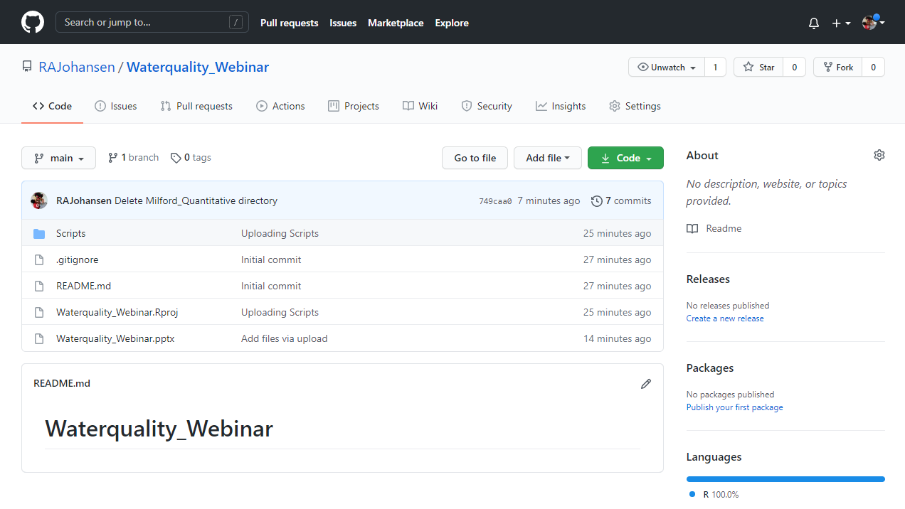
Water Quality Vignette

